Slide 1
MONEY MARKET INDICES
National Bank of Kazakhstan
  EBRD Treasury
1st February 2019
OFFICIAL USE

Slide 2
Agenda
Review of the conclusions of the second working group meeting’
Implementation results of the 2nd meeting of the working group protocol decisions
Proposal for reformed for reformed TONIA Calculation methodology
Seasonal factors of the money and foreign exchange markets: tax weeks, budget spending (NBK)
Importance of settlement for efficient money markets
Q&A
OFFICIAL USE

Slide 3
Guiding principles for a reliable Money Market benchmark rate
Some considerations for RFR
Guiding principles for a reliable MM interest rate benchmark
Transparent definition that is robust to adverse changes in market structure
Reflecting a tradable underlying by market participants
Expressive of the policy target of the Central Bank
Minimal opportunities for market manipulation
Conducive to building a term extension and curve
Appropriate Governance
- RFR adopted in G7 currencies all based on actual transactions
- Secured vs unsecured traded volumes
- What segment of the market (eg Sonia interbank, Ester borrowing cost for banks from all sources)
- To be defined by the Administrator (with market participants)
- Market needs to be comfortable can use benchmark for long term transactions => important consideration when deciding for secured vs. unsecured
… but can be secured even if operational target unsecured (and vice versa) e.g. SOFR
Are secured rates more volatile than unsecured and what do market participants and end users prefer to use as a reference?
- Underlying volumes
- Transparent contributions
- Calculation methodology (exclude extremes?, exclude trades with some counterparties? Fall-backs?)
- Who will be the Administrator?
- Does the Administrator need to be approved by some parties using the benchmark? (e.g. European Benchmark regulation)
- Frequency and rules for review
- Develop an IRS / OIS market
- Discussion on Term fixing

Slide 4
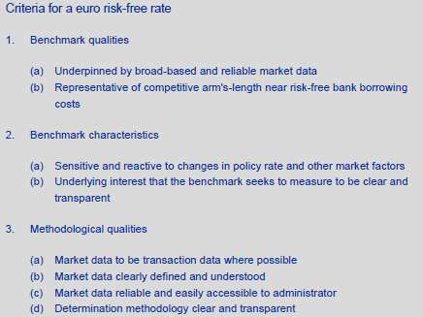
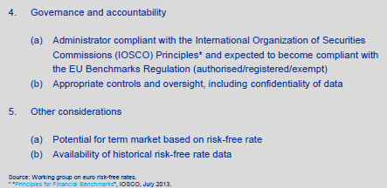
G7 assessment criteria example - €
Focus of last WG meeting
Today’s WG focus

Slide 5
Assessment of
KZT O/N RFR candidates

Slide 6
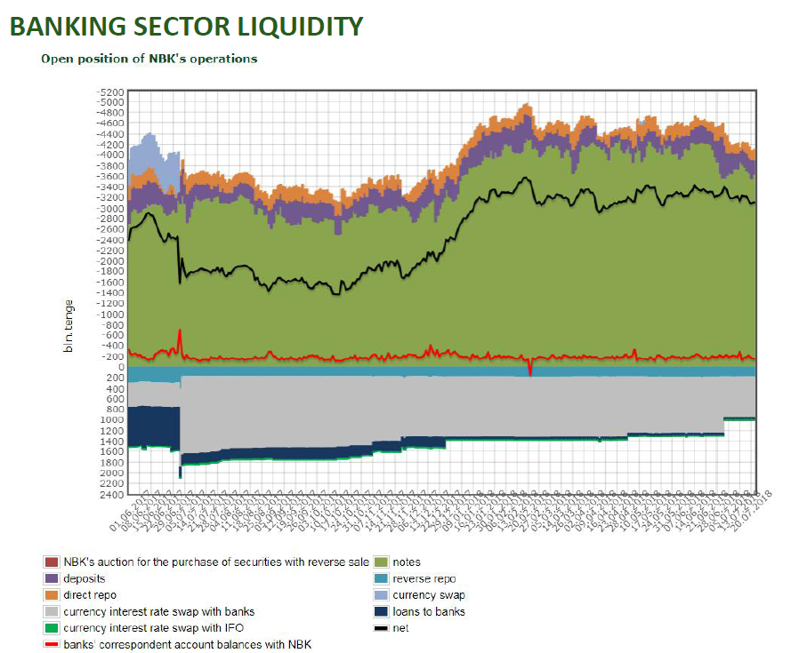
KZT market liquidity

Slide 7
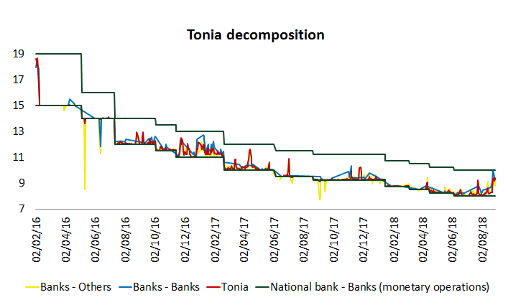
Tonia decomposition

Slide 8
Tonia decomposition

Slide 9
Tonia decomposition

Slide 10

Proposed reformed Tonia methodology
Contingency Plan
Data collection
Calculation
Publication
Review and Evolution of the Methodology
10

Slide 11
Proposed Definition
On each Almaty business day (the “Fixing Day”), the Benchmark is measured as the trimmed mean, rounded to four decimal places, of interest rates paid on eligible KZT denominated secured transactions.
The trimmed mean is calculated as the volume-weighted mean rate, based on the central 70% of the volume-weighted distribution of rates.
Eligible transactions are:
    • All Repo transactions executed on Kase?
    • Reported by Kase? Or to the NBK by Kase?;
    • Secured and of one business day maturity;
    • Executed between XX:00 hours and YY:00 hours Almaty time and settled that same-day;
    • Greater than or equal to KZT XX million in value .
11

Slide 12
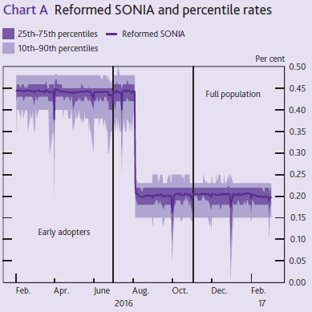
Why trim?
To exclude outliers, have index less open to manipulation and less volatile

Slide 13
The Calculation Methodology
Step 1 : All eligible transactions traded on any given Fixing Day are ranked from the smallest to the largest with respect to the nominal interest rate reported on these transactions :
Yield
Volume
Transaction 1
8.35%
100 mio
Transaction 2
8.30%
300 mio
Transaction 3
8.30%
100 mio
Transaction 4
8.28%
50 mio
Transaction 5
8.26%
150 mio
Transaction 6
8.25%
1 bio
Transaction 7
8.25%
250 mio
Transaction 8
8.25%
50 mio
OFFICIAL USE
Notes:
Check size of transactions

Slide 14
The Calculation Methodology
Step 2 : All the transactions with the same nominal interest rate are merged in order to have one line per nominal interest rate. Each rate is associated with the cumulative traded volume :
Yield
Volume
Transaction 1
8.35%
100 mio
Transaction 2
8.30%
300 mio
To be merged
Transaction 3
8.30%
100 mio
Transaction 4
8.28%
50 mio
Transaction 5
8.26%
150 mio
Transaction 6
8.25%
1 bio
Transaction 7
8.25%
250 mio
To be merged
Transaction 8
8.25%
50 mio
OFFICIAL USE

Slide 15
The Calculation Methodology
Step 2 : All the transactions with the same nominal interest rate are merged in order to have one line per nominal interest rate. Each rate is associated with the cumulative traded volume :
Yield
Volume
Line 1
8.35%
100 mio
Line 2
8.30%
400 mio
Line 3
8.28%
50 mio
Line 4
8.26%
150 mio
Line 5
8.25%
1.3 bio
OFFICIAL USE

Slide 16
The Calculation Methodology
Step 3 : The top and the bottom 15 percent of the traded volumes are detected as outliers and removed from the observations :
Yield
Volume
Line 1
8.35%
100 mio
Top 15% of the traded volumes to be removed
Line 2
8.30%
400 mio
Line 3
8.28%
50 mio
Line 4
8.26%
150 mio
Line 5
8.25%
1.3 bio
Bottom 15% of the
traded volumes to be removed
OFFICIAL USE

Slide 17
The Calculation Methodology
Step 3 : The top and the bottom 15 percent of the traded volumes are detected as outliers and removed from the observations :
Yield
Volume
Line 1
8.30%
200 mio
Line 2
8.28%
50 mio
Line 3
8.26%
150 mio
Line 4
8.25%
1 bio
OFFICIAL USE

Slide 18
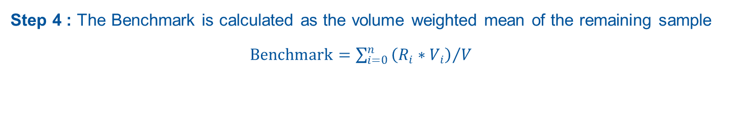
The Calculation Methodology
Step 4 : The Benchmark is calculated as the volume weighted mean of the remaining sample $Benchmark=\sum_{i=0}^{n}{{\left(R_{i}∗V_{i}\right)}/V}$
Benchmark = (8.30% * 200 + 8.28% * 50 + 8.26% * 150 + 8.25% * 1000) / 1400
Benchmark = 8.2593%
OFFICIAL USE

Slide 19
Historical illustration

Slide 20
Publication
T0
T + 1
Data collection
Calculation
Publication
10 am
In case of error, the index can be recalculated with updated data
If the difference is larger than [3] bps, the benchmark will be republished.
20

Slide 21
Contingency plan
The Administrator will consider that the data submitted by the reporting banks on a given day are sufficient to calculate the Benchmark rate unless:
    The total number of eligible transactions is below XX
    The total number of reporting banks is below XX
    the total volume of the eligible transactions is below KZT XX billion
If these data sufficiency conditions are not met, the Benchmark rate will be determined as the NBK Refinancing Rate plus the mean of the spread of the Benchmark to the Refinancing Rate over the previous five publication days, excluding the days with the highest and lowest spread to the Refinancing Rate.
21

Slide 22
Revision and evolution of the methodology
The Administrator will review, at least annually, the current methodology with a view to ensuring that it continues adequately to measure the Underlying Interest:
Has the market undergone or is undergoing structural change that may warrant changes to the benchmark methodology?
does the market continue, and is expected to continue, to function sufficiently well and have sufficient volumes to form the basis for a robust and credible benchmark?
The Administrator will also take account of representations from users of the Benchmark and the Working Group participants as to the possible need for changes in the methodology.
If the Administrator determines, on the basis of its review, that changes to the benchmark methodology are warranted, it may make such changes after consultation with the Working Group participants.
22

Slide 23
Importance of settlement for efficient money markets
Importance of being able to use funds efficiently …
… i.e. being able to credit and debit funds with same value date without losing days of interest.
This can be impacted by various factors, for example:
    Absence of overdraft agreements (interbank or with the central bank)
    Cut-off time too early for some payments
    Availability of collateral?
    Other factors in Kazakhstan?
Not being able to do so can lead to:
    Settlement failures in chain
    Prefunding of payments (even more problematic for T+2 settlements)
    Discouraging market participation (and liquidity), especially from international counterparties
B
C
A
Notes:
Check settlement fund for T+2
We have seen chain failure increase
settlement failure risk becoming as important as credit and liquidity risk

Slide 24
International ‘best practices’
Most of EBRD Correspondent Banks offer some form of liquidity facility allowing payments to be made regardless of a negative balance.
If we receive a late payment from a counterparty/client within the G7 countries, we can arrange:
      Back Valuation
      Request our Bank to arrange ‘good value’ by arranging Back Valuation. This is usually a flat fee of around USD 300 or EUR 300 as opposed to debit interest which can be 1pct or more above Libor/Eonia
Outside of the G7 countries Back Valuation is not offered, therefore other instruments should be put into place to ensure that payments are made regardless of short balances caused by timing issues or non-receipt of funds, some options are:
      Overdraft Facility
      An Overdraft facility allows our account to be overdrawn up to a specified amount. The account will then be charged with Overdraft Interest at an agreed rate usually tied to the Central Bank rates.
      Intraday Credit Facility
      An Intraday overdraft facility covers debit transactions that occur during the day regardless of balance with the intention that the account is flat by close of business same day.

Slide 25
Q&A

Slide 26
ANNEXES

Slide 27
Money Market Development Framework
  Based on publication by EBRD and OG Research called “Framework for Developing Money Markets in Frontier and Emerging Market Economies”
  Blueprint for money markets transformed into diagnostic framework with Handbook and Questionnaire
    Helping regulators and TA providers to assess state of development of money market
    Helping to identify areas in which TA would be most beneficial to advance activity
  Public tool – available subject to signing Terms of Use
    Frontclear will list Registered Users and Countries of Applications
  Frontclear and OG Research can provide TA on application of tool
  Frontclear aims to maintain database with results of application
    To allow for peer comparison between countries of application
    To be able to track developments through time

Slide 28
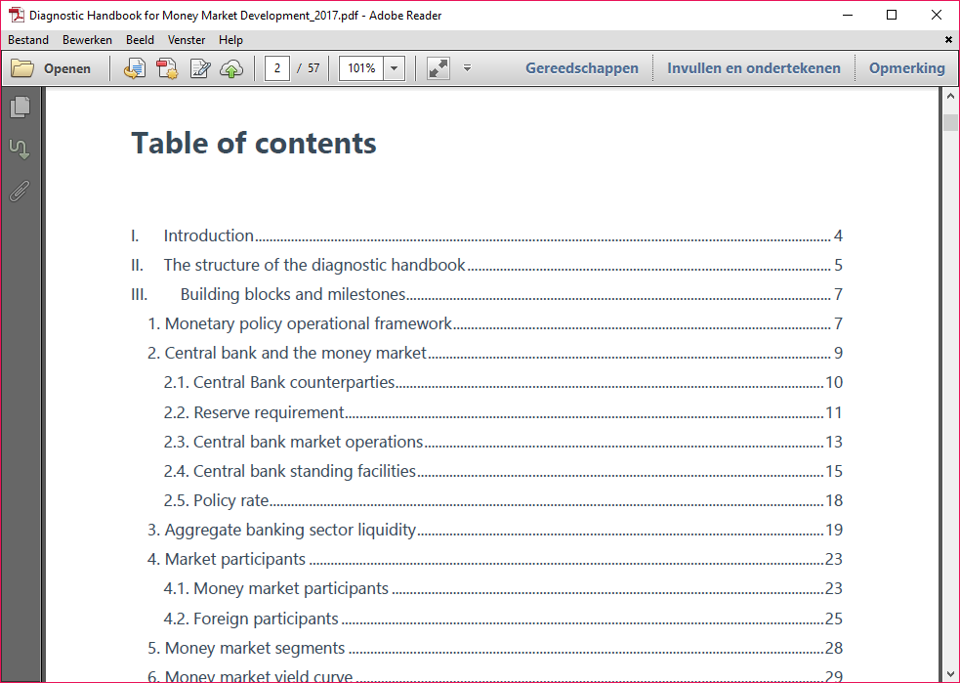
MMDF - Handbook
Handbook provides an overview of all the building blocks in the Questionnaire
Introduces the theoretical concept of each building blocks
Lists the main outcomes and recommendation to each building block

Slide 29
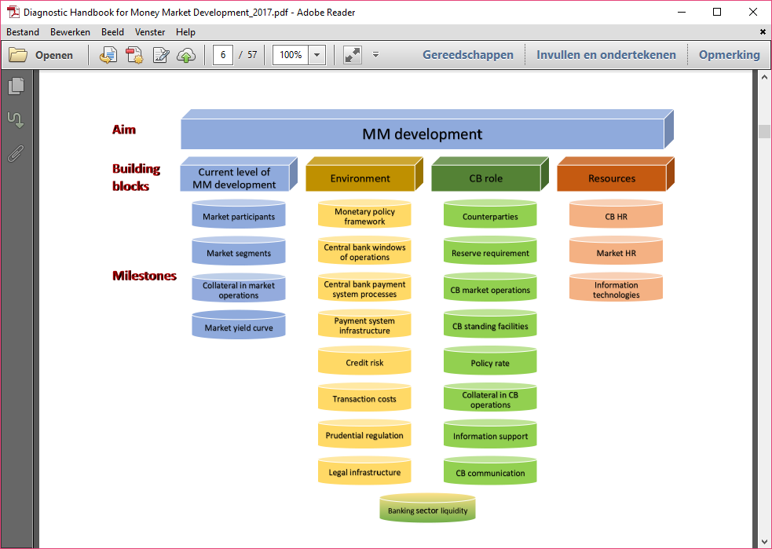
MMDF - Handbook

Slide 30
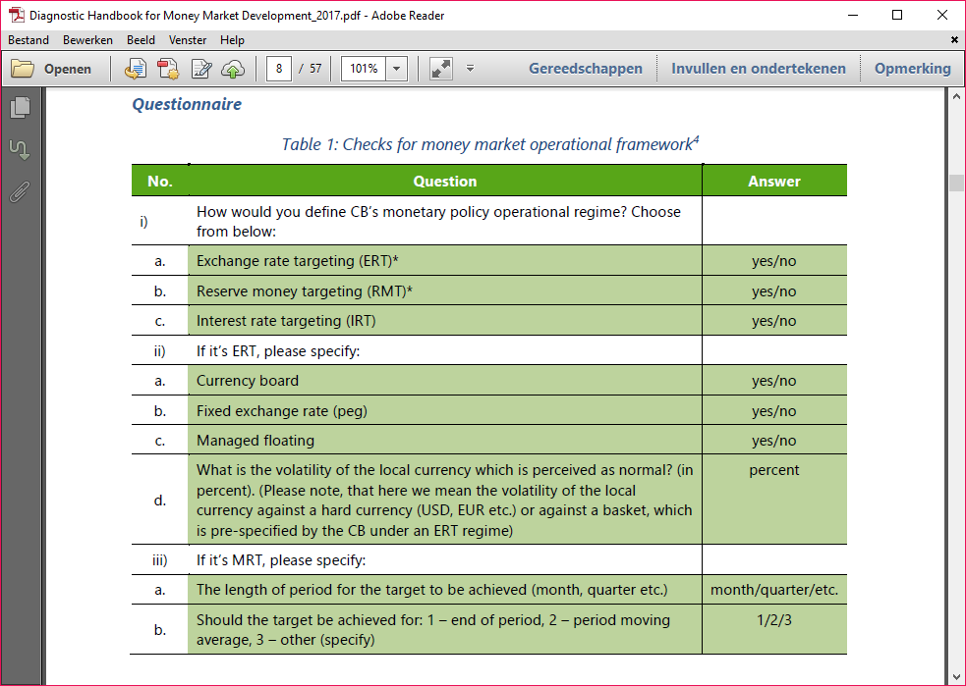
MMDF - Handbook

Slide 31
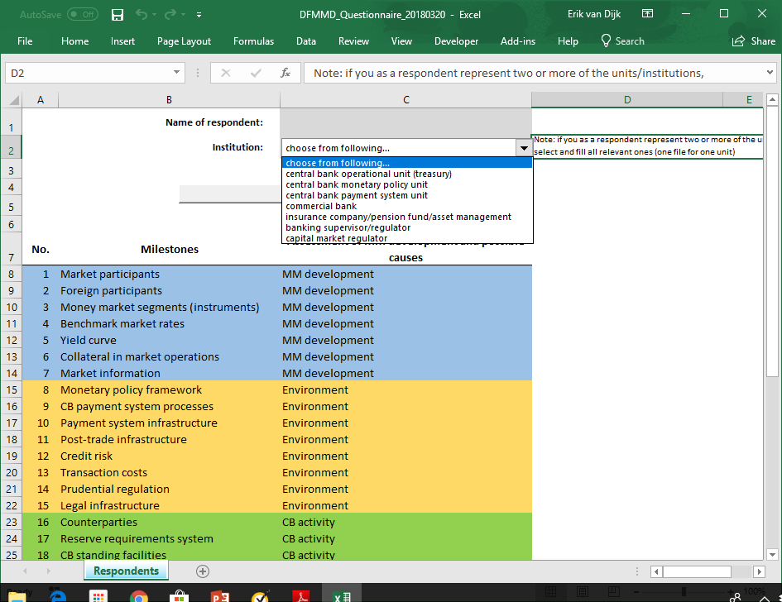
MMDF - Questionnaire

Slide 32
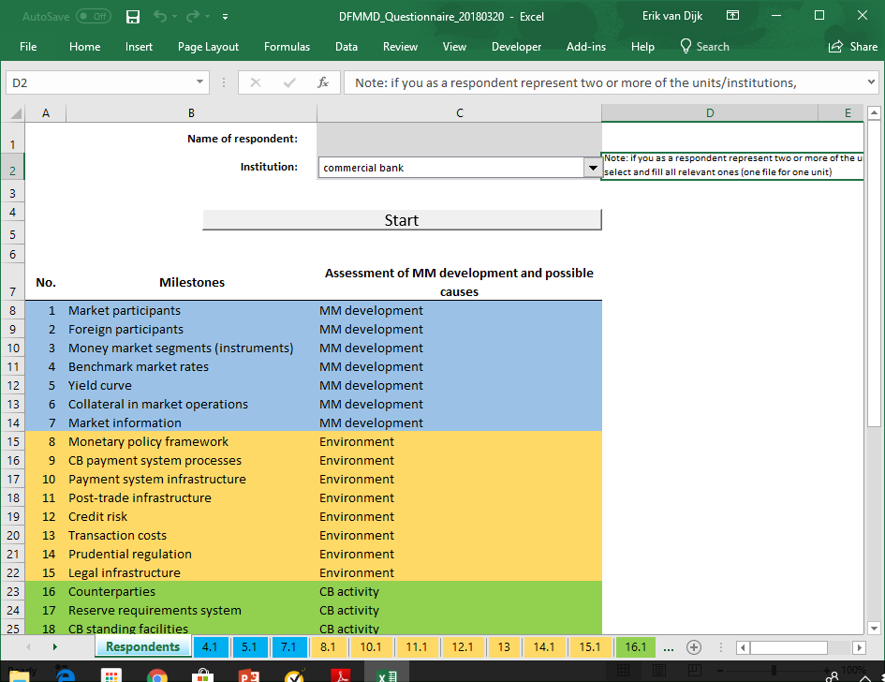
MMDF - Questionnaire

Slide 33
MMDF - Output

Slide 34
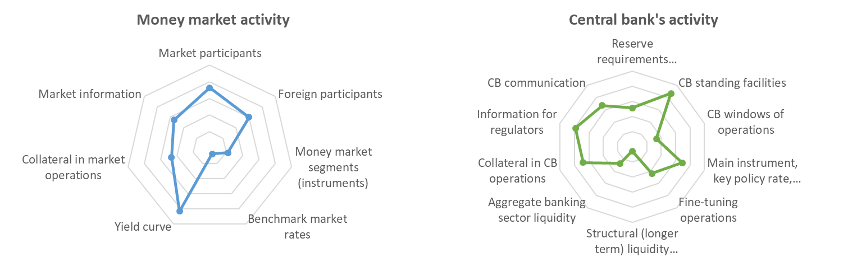
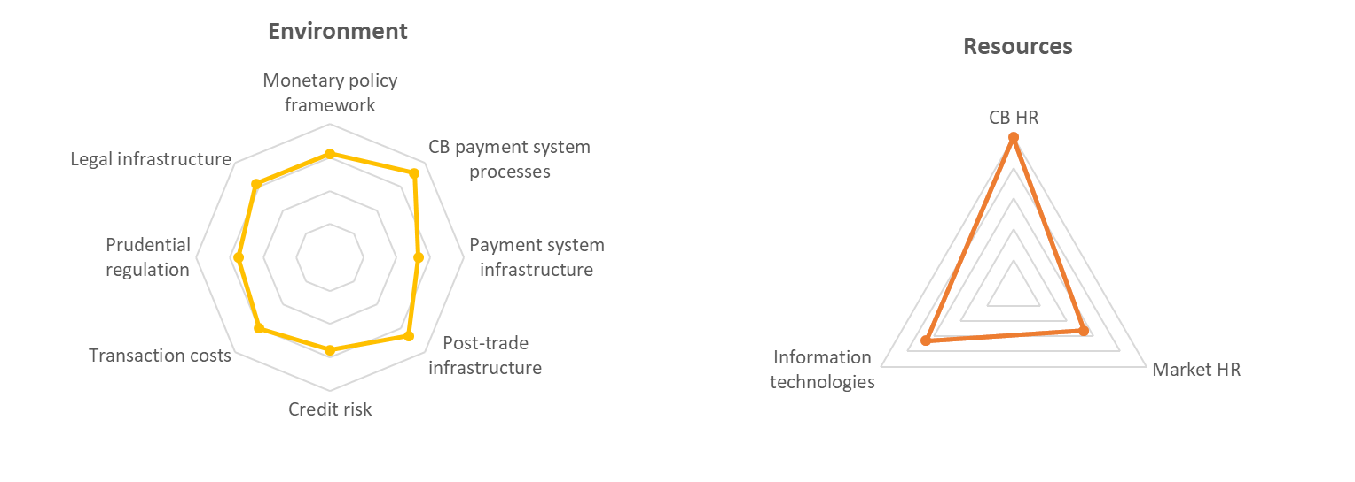
MMDF - Output

Slide 35
Reformed SONIA key features
Definition of SONIA
The definition of SONIA has two elements:
      (i) Statement of underlying interest:
          SONIA is a measure of the rate at which interest is paid on sterling short-term wholesale funds in circumstances where credit, liquidity and other risks are minimal.
(ii) Statement of methodology
SONIA is measured as the volume-weighted mean rate, based on the central 50% of the volume-weighted distribution of rates, paid on eligible sterling denominated deposit transactions.
Review and evolution of the methodology
Periodic review of the methodology
The Bank periodically reviews the current methodology with a view to ensuring that it continues adequately to measure the underlying interest.
Changes to methodology
If the Bank determines, on the basis of its review, that changes to the benchmark methodology are warranted, it may make such changes.
Such changes may include, for example, refinements to the calculation methodology or scope of eligible transactions within the relevant market. They may also include the introduction of a methodology which has reference to other actively traded money market instruments, for example UK‑gilt collateralised repurchase agreements, or to the Bank of England official interest rates, so long as the Bank considers that they provide an appropriate measure of the underlying interest.

Slide 36
Reformed SONIA key features continue
SONIA republication policy
SONIA will be republished on a given day if the calculation of the benchmark based on the most up-to-date data is two or more basis points away from the earlier published rate. Republication will be no later than midday on the same day, but the Bank would republish earlier if ready to do so. The Bank will only republish SONIA once for a given day.
No amendments after republication deadline will be made to the benchmark rate under any circumstances
Short-term contingency arrangements
The Bank will consider that the data submitted via its Sterling Money Market daily data collection are sufficient to produce SONIA unless:
five or more reporters in the unsecured population have failed to submit a valid file; and
the volume of SONIA-eligible transactions is <70% of the mean of the previous five business days for which SONIA has been calculated in line with the statement of methodology.
If these data sufficiency conditions are not met, SONIA will be determined as:
The level of Bank Rate plus the mean of the spread of SONIA to Bank Rate over the previous five publication days, excluding the days with the highest and lowest spread to Bank Rate. For these purposes the relevant level of Bank Rate is that at the close of the SONIA transaction window.
http://www.bankofengland.co.uk/markets/Documents/soniafeaturespolicies.pdf

Slide 37
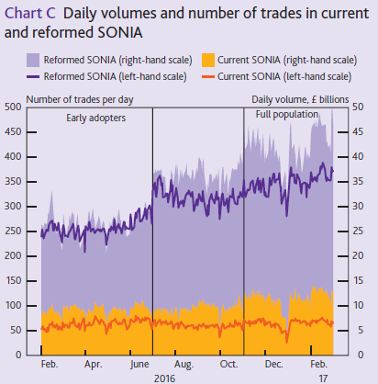
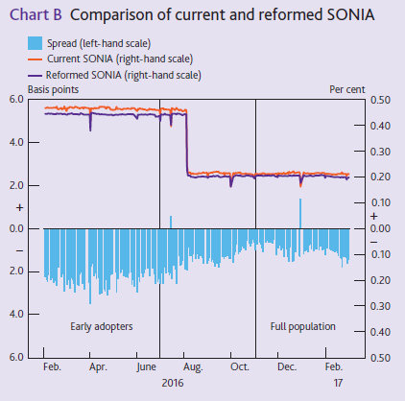
Assessment example
Reformed Sonia
Notes:
March 2017 - The reform of SONIA - Consultation feedback and the design of SONIA

Slide 38
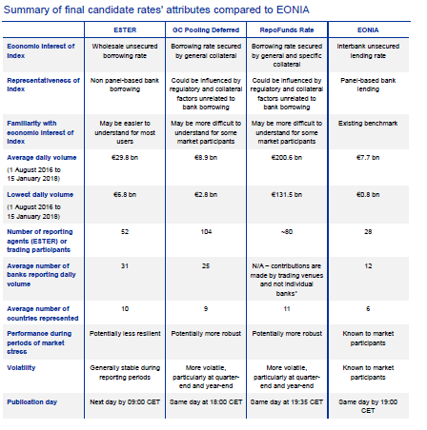
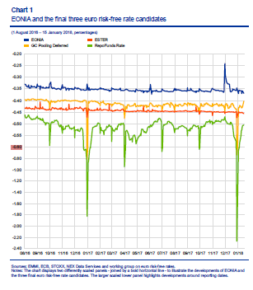
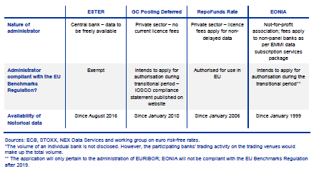
Assessment example
€ RFR
Notes:
Link to consultation paper:
https://www.ecb.europa.eu/paym/pdf/cons/euro_risk-free_rates/consultation_details_201806.en.pdf

Slide 39
Disclaimer
This information is provided for discussion purposes only, may not be reproduced or redistributed and does not constitute an invitation or offer to subscribe for or purchase any securities, products or services. No responsibility is accepted in respect of this presentation by its author, the European Bank for Reconstruction and Development (the "Bank") or any of its directors or employees (together with the author and the Bank, the "EBRD") for its contents. The information herein is presented in summary form and does not attempt to give a complete picture of any market, financial, legal and/or other issues summarised or discussed. The EBRD is not acting as your advisor or agent and shall have no liability, contingent or otherwise, for the quality, accuracy, timeliness, continued availability or completeness of the information, data, calculations nor for any special, indirect, incidental or consequential damages which may be experienced because of the use of the material made available herein. This material is provided on the understanding that (a) you have sufficient knowledge and experience to understand the contents thereof; and (b) you are not relying on us for advice or recommendations of any kind (including without limitation advice relating to economic, legal, tax, regulatory and/or accounting risks and consequences) and that any decision to adopt a strategy, deal in any financial product or enter into any transaction is based upon your own analysis or that of your professional advisors, whom you shall consult as you deem necessary.

